Slide 1
Performance Comparison of different molecular data in the identification of DIABETIC RETINOPATHY
EC7070 – COMPUTER ENGINEERING RESEARCH PROJECT II
Supervisor
Dr. Pratheeba J.
By
2019/E/011 : Miss. Ashfa A.G.F.
2019/E/023 : Mr. Chandrasiri H.V.B.L.
01
Notes:
pratheeba Jeyananthan

Slide 2
INTRODUCTION
Diabetic retinopathy is a severe eye disease that can lead to blindness. Early detection and treatment of diabetic retinopathy can help to prevent blindness.
Currently, the diagnosis of DR primarily relies on clinical evaluation and imaging techniques, such as fundus photography or optical coherence tomography.
In here, we are using various molecular data, including DNA, RNA, and protein, to develop a model that can accurately predict the presence of diabetic retinopathy using Machine Learning.
02
Notes:
NPDR – nonproliferative diabetic retinopathy
PDR - proliferative diabetic retinopathy
Light waves

Slide 3
In Our Research,
There is a need for further research to evaluate and compare the effectiveness of molecular data types with machine learning approaches and investigate the potential synergistic effects.
03
Notes:
multiple substances or factors produces an effect that is greater than the sum of their individual effects.

Slide 4
LITERATURE REVIEW
04

Slide 5
[1] Plasma Metabolomics Reveals Metabolic Profiling For Diabetic Retinopathy and Disease Progression
to different metabolic pathways were identified and confirmed to be associated with the occurrence of DR. (Plasma Metabolites)
[2] High Serum Neuron-Specific Enolase Level is Associated with Mild Cognitive Impairment in Patients with Diabetic Retinopathy
Compared with the normal cognition group, serum NSE levels and HbA1c levels in the MCI group were higher, while MMSE scores and educational level were lower (P<0.05)(Patients’ demographic and clinical data )
[3] Identification of Diabetic Retinopathy through Machine Learning
The RBM model of machine learning automatic disease detection performed well(diabetics persons’ eyes)
[4] A critical review on diagnosis of diabetic retinopathy using machine learning and deep learning
A detailed review on DR, its features, causes, ML models, state-of-the-art DL models, challenges, comparisons and future directions, for early detection of DR.(Retinal images)
[5] Automated diabetic retinopathy detection using radial basis function
Radial basis function neural network classifier, and Image processing techniques.(retinal images)
05
Notes:
MMSE- Mini-Mental State Examination
MCI – Mild Cognitive Impairment RBM- Restricted Boltzman Machine

Slide 6
[6] Optimized hybrid machine learning approach for smartphone based diabetic retinopathy detection
using enhanced ML and DL methods with new different optimization algorithms for accomplishing the maximum detection rate.(Retinal Images)
[8] Machine learning in clinical decision making
the integration of machine-learning platforms into clinical medicine in future.(Clinical data)
[9] Artificial intelligence in current diabetes management and prediction
Introduce AI/ML-based medical devices and prediction models regarding diabetes.(Hospital dataset)
[10] Deep learning for healthcare: review, opportunities and challenges, Briefings in bioinformatics
deep learning approaches could be the vehicle for translating big biomedical data into improved human health each papers are given single point review. (Clinical imaging data)
06

Slide 7
Gap In The Literature
[5] Kamble, Vaibhav V., and Rajendra D., “Automated diabetic retinopathy detection using radial basis function”, Procedia Computer Science, vol.167, no. , pp. 799-808, 2020. Available: 10.1016/j.procs.2020.03.429.
As they using abnormal and excessive bleeding from blood vessels presence in retinal image there is a possibility that it caused by other factors rather than diabetic.
The performance of the system in detecting diabetic retinopathy may heavily rely on the quality and clarity of the retinal images used.
The research has several limitations, including a small sample size, a single type of neural network.
07
Notes:
Radial Basis Function (RBF) is a mathematical function that assigns an output value based on the distance between the input and a center point.

Slide 8
Plan of Our Work
Proposal Writing
Implementation Process
01
02
03
04
05
Review
Previous Articles
Dataset
Preparation
Analyse Results & Document Preparation
Literature Review
Annotated Bibiliography
Compare Accuracies for each subtype
08

Slide 9
Methodology
Data Collection
Data Preprocess
Feature Selection
Model Building
Find Effectiveness
09

Slide 10
Data to be used in this work
Alterations of 5-Hydroxymethylcytosines in Circulating Cell-free DNA Reflect Retinopathy in Type 2 Diabetes
This contains genome-wide methylation profiles of circulating cell-free DNA (cfDNA) from 70 Chinese patients with type 2 diabetes mellitus (T2DM), including 35 patients with diabetic retinopathy (DR) and 35 age-, gender-, and diabetic duration-matched controls.
10
Notes:
GEO website-Gene Expression Omnibus
18000 near

Slide 11
Data to be used in this work
In-depth transcriptomic analyses investigating molecular mechanisms underlying diabetic retinopathy
This is a collection of transcriptomic data from human post-mortem retinal samples. The data was collected from 80 patients diagnosed with various stages of diabetic retinopathy (DR). The data was analyzed using RNA-Seq, a high-throughput sequencing technique that can measure gene expression in a sample.
totalRNA
smallRNA
11
Notes:
Small -2576
Total – 58000 near

Slide 12
Data Preprocessing
Extract Target Values from Website
Check Null Values
Check Features to Normalize
1
2
3
12

Slide 13
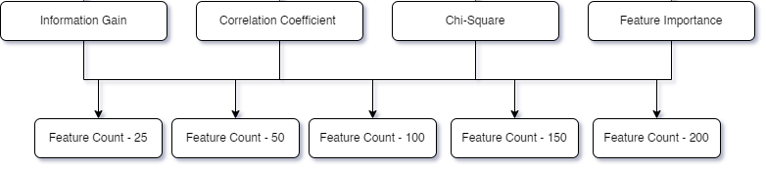
Feature Selection
Cross-Validation
Create new Data Sets , Feature Count from 1 – No. of Instances
13
Notes:
Narrow down our research scope
More complex

Slide 14
14
Notes:
All scores has Std below ± 0.15

Slide 15
Feature Selection Results - DNA Methylation
Algorithm | Information Gain | Correlation Coefficient | Chi-Square | Feature Importance
Feature Count
25 | 0.44 ± 0.03 | 0.86 ± 0.12 | 0.81 ± 0.13 | 0.67 ± 0.10
50 | 0.44 ± 0.03 | 0.91 ± 0.08 | 0.77 ± 0.14 | 0.71 ± 0.06
100 | 0.44 ± 0.03 | 0.91 ± 0.07 | 0.83 ± 0.07 | 0.77 ± 0.10
150 | 0.44 ± 0.03 | 0.96 ± 0.06 | 0.91 ± 0.05 | 0.83 ± 0.06
200 | 0.44 ± 0.03 | 0.93 ± 0.05 | 0.91 ± 0.03 | 0.89 ± 0.06
15

Slide 16
smallRNA
Algorithm | Information Gain | Correlation Coefficient | Chi-Square | Feature Importance
Feature Count
25 | 0.30 ± 0.05 | 0.37 ± 0.06 | 0.37 ± 0.06 | 0.72 ± 0.15
50 | 0.30 ± 0.05 | 0.37 ± 0.06 | 0.37 ± 0.06 | 0.81 ± 0.04
100 | 0.30 ± 0.05 | 0.37 ± 0.06 | 0.37 ± 0.06 | 0.85 ± 0.03
150 | 0.30 ± 0.05 | 0.38 ± 0.08 | 0.38 ± 0.08 | 0.85 ± 0.03
200 | 0.30 ± 0.05 | 0.37 ± 0.06 | 0.37 ± 0.06 | 0.85 ± 0.05
totalRNA
Algorithm | Information Gain | Correlation Coefficient | Chi-Square | Feature Importance
Feature Count
25 | 0.37 ± 0.08 | 0.51 ± 0.14 | 0.51 ± 0.14 | 0.74 ± 0.14
50 | 0.37 ± 0.08 | 0.51 ± 0.14 | 0.51 ± 0.14 | 0.74 ± 0.14
100 | 0.37 ± 0.08 | 0.51 ± 0.14 | 0.51 ± 0.14 | 0.76 ± 0.10
150 | 0.37 ± 0.08 | 0.51 ± 0.14 | 0.51 ± 0.14 | 0.80 ± 0.11
200 | 0.37 ± 0.08 | 0.51 ± 0.14 | 0.51 ± 0.14 | 0.77 ± 0.11
16

Slide 17
Models Building
Model Building and Evaluation
SVM
ANN
Naïve Bayes
Logistic Regression
Random Forest
XGBoost
Cross-Validation
17
Notes:
SVM identifies support vectors (data points closest to the decision boundary) and optimizes the hyperplane's position to achieve the largest possible margin.
ANN - Information flows through layers of nodes. Input data is passed through the network, and weights and biases are adjusted iteratively through training to make predictions or solve a specific problem.
Naïve Bayes - calculates the conditional probability of a data point belonging to a class based on the likelihood of features and prior probabilities.
Logistic - It uses the logistic function (sigmoid) to model the probability of an event occurring as a function of the input features.
Random Forest - It builds a collection of decision trees by randomly selecting subsets of data and features for training.
XGBoost - It sequentially builds decision trees in an additive manner, optimizing for the residual errors left by the previous trees.

Slide 18
Model Building Results - DNA Methylation
18

Slide 19
Model Building Results - DNA Methylation
Model Name | Feature Count | CV Score (Mean +/- Std)
Logistic Regression | 48 | 0.9571 +/- 0.0350
SVM(linear) | 50 | 0.9571 +/- 0.0350
SVM(linear) | 51 | 0.9571 +/- 0.0350
SVM(linear) | 52 | 0.9571 +/- 0.0350
SVM(linear) | 53 | 0.9571 +/- 0.0350
SVM(linear) | 54 | 0.9571 +/- 0.0350
SVM(linear) | 61 | 0.9571 +/- 0.0350
SVM(linear) | 48 | 0.9429 +/- 0.0535
ANN | 49 | 0.9429 +/- 0.0535
SVM(linear) | 60 | 0.9429 +/- 0.0286
19

Slide 20
Model Building Results - smallRNA
20

Slide 21
Model Building Results - smallRNA
Model Name | Feature Count | CV Score (Mean +/- Std)
ANN | 59 | 0.9500 +/- 0.0468
ANN | 72 | 0.9500 +/- 0.0468
ANN | 73 | 0.9500 +/- 0.0468
ANN | 74 | 0.9500 +/- 0.0468
ANN | 75 | 0.9500 +/- 0.0468
ANN | 76 | 0.9500 +/- 0.0468
ANN | 77 | 0.9500 +/- 0.0468
ANN | 78 | 0.9500 +/- 0.0468
ANN | 79 | 0.9375 +/- 0.0559
SVM(poly) | 43 | 0.9375 +/- 0.0559
21

Slide 22
Model Building Results - totalRNA
22

Slide 23
Model Building Results - totalRNA
Model Name | Feature Count | CV Score (Mean +/- Std)
Naive Bayes | 14 | 0.9625 +/- 0.0500
Naive Bayes | 15 | 0.9625 +/- 0.0306
Naive Bayes | 16 | 0.9625 +/- 0.0306
Random Forest | 43 | 0.9500 +/- 0.0250
ANN | 78 | 0.9375 +/- 0.0559
ANN | 52 | 0.9375 +/- 0.0395
SVM(poly) | 20 | 0.9375 +/- 0.0395
ANN | 55 | 0.9375 +/- 0.0395
ANN | 61 | 0.9375 +/- 0.0395
ANN | 64 | 0.9375 +/- 0.0395
23

Slide 24
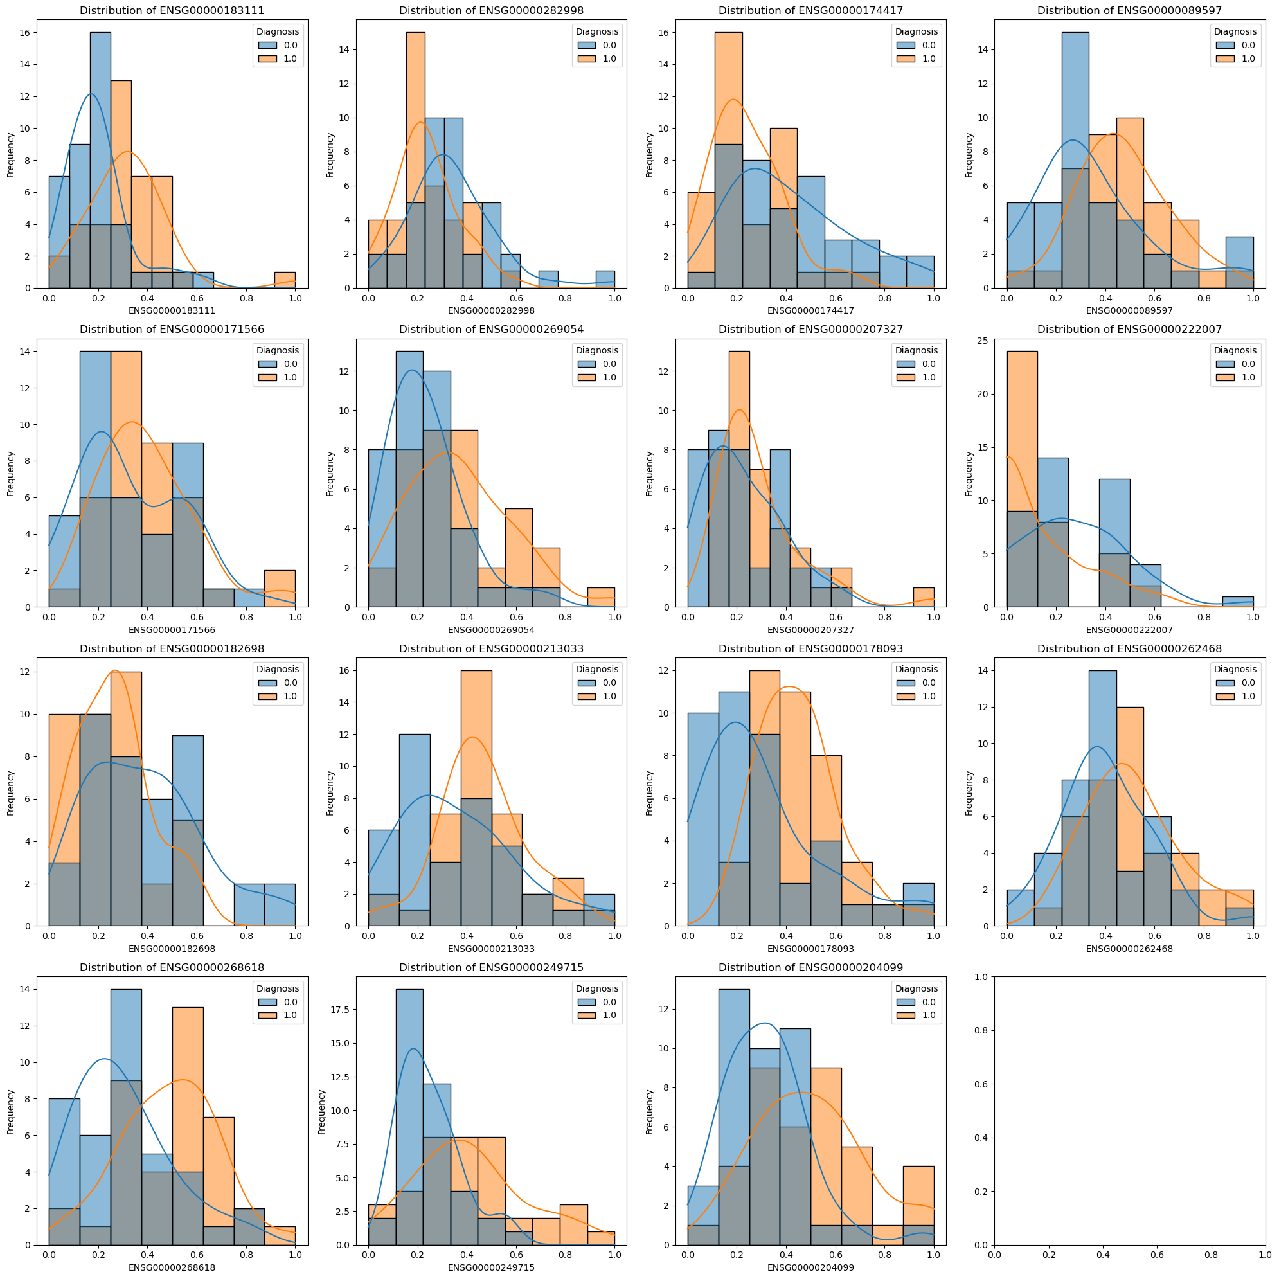
Distribution Analysis
24

Slide 25
Select the Best type of Single Omic data
25

Slide 26
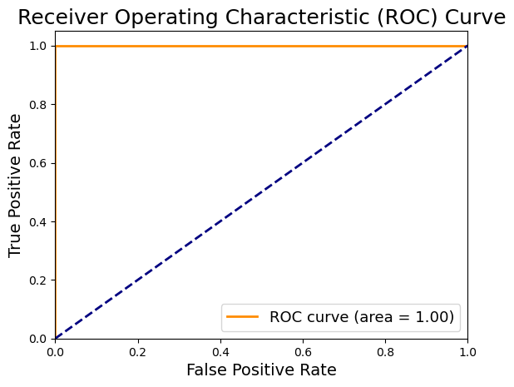
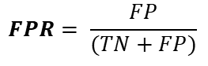
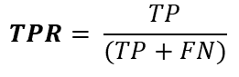
Find Effectiveness
$$TPR= \frac{TP}{(TP+FN)}$$
TN
FP
$$FPR= \frac{FP}{(TN+FP)}$$
TP
26

Slide 27
Timeline
ACTIVITY | SEMESTER 6 |  |  |  | SEMESTER 7 |  |  |  | SEMESTER 8
 | W 1 | W 2-8 | W 9-12 | W 13-15 | W 1 | W 2-4 | W 5-10 | W 10-15 | W 1-2 | W 2-4 | W 4-6 | W 6-8
Literature Review
Annotated Bibiliography
Research Proposal
Data Collection
Data Preparation
Build the Model
Experimenting the Model
Research Project Report Writing
Research Paper Writing
27

Slide 28
REFERENCES
[1] Y. Sun, H. Zou, X. Li, S. Xu, and C. Liu, “Plasma metabolomics reveals metabolic profiling for diabetic retinopathy and disease progression,” Frontiers, 29-Sep-2021.
[2] Z.-W. Yu et al., “&lt;p&gt;High Serum Neuron-Specific Enolase Level Is Associated with Mild Cognitive Impairment in Patients with Diabetic Retinopathy&lt;/p&gt;,” Diabetes, Metabolic Syndrome and Obesity: Targets and Therapy, pp. 1359–1365, Apr. 2020, doi: 10.2147/dmso.s249126.
[3] M. Bader Alazzam, F. Alassery, and A. Almulihi, “Identification of diabetic retinopathy through machine learning,” Mobile Information Systems, 26-Nov-2021.
28

Slide 29
REFERENCES
[4] Das, D., Biswas, S.K. and Bandyopadhyay, S., “A critical review on the diagnosis of diabetic retinopathy using machine learning and deep learning”, Multimedia Tools and Applications, vol.81 (18), no., pp.25613-25655, 2022. Available: 10.1007/s11042-022-12642-4.
[5] Kamble, Vaibhav V., and Rajendra D., “Automated diabetic retinopathy detection using radial basis function”, Procedia Computer Science, vol.167, no. , pp. 799-808, 2020. Available: 10.1016/j.procs.2020.03.429.
29

Slide 30
REFERENCES
[6] Gupta, S., Thakur, S. and Gupta, A., “Optimized hybrid machine learning approach for smartphone based diabetic retinopathy detection”, Multimedia Tools and Applications, vol.81 (10), pp.14475-14501, 2022.
[7] G. L. D’Adamo, J. T. Widdop, and E. M. Giles, “The future is now? clinical and translational aspects of ‘OMICS’ technologies,” Immunology & Cell Biology, vol. 99, no. 2, pp. 168–176, 2020.
[8] L. Adlung, Y. Cohen, U. Mor, and E. Elinav, “Machine learning in clinical decision making,” Med, vol. 2, no. 6, pp. 642–665, Jun. 2021, doi: .
30

Slide 31
REFERENCES
[9] Nomura, A., Noguchi, M., Kometani, M., Furukawa, K. and Yoneda, T., “Artificial intelligence in current diabetes management and prediction”, Current Diabetes Reports, vol.21(12), pp.61, 2021. Available: 10.1007/s11892-021-01423-2.
[10] Miotto, R., Wang, F., Wang, S., Jiang, X., & Dudley, J. T.,, vol.19(6), pp.1236-1246, 2018. Available: 19/6/1236/38005Deep learning for healthcare: review, opportunities and challenges, Briefings in bioinformatics24
[11] M. Leeza and H. Farooq, “Detection of severity level of diabetic retinopathy using Bag of features model,” IET Computer Vision, vol. 13, no. 5, pp. 523–530, Aug. 2019, doi: 10.1049/ietcvi.2018.5263.
31

Slide 32
REFERENCES
[12] J. H. Yun, J. M. Kim, H. J. Jeon, T. Oh, H. J. Choi, and B. J. Kim, “Metabolomics profiles associated with diabetic retinopathy in type 2 diabetes patients,” PLoS One, vol. 15, no. 10 October 2020, Oct. 2020, doi: 10.1371/journal.pone.0241365.
[13] L. Math and R. Fatima, “Adaptive machine learning classification for diabetic retinopathy,” Multimed Tools Appl, vol. 80, no. 4, pp. 5173–5186, Feb. 2021, doi: 10.1007/s11042-020-09793- 7.
[14] S. Deuchler et al., “Vitreous expression of cytokines and growth factors in patients with diabetic retinopathy- An investigation of their expression based on clinical diabetic retinopathy grade,” PLoS One, vol. 16, no. 5 May, May 2021, doi: 10.1371/journal.pone.0248439.
32

Slide 33
REFERENCES
[15] H. Y. Zhang, J. Y. Wang, G. S. Ying, L. P. Shen, and Z. Zhang, “Serum lipids and other risk factors for diabetic retinopathy in Chinese type 2 diabetic patients,” J Zhejiang Univ Sci B, vol. 14, no. 5, pp. 392–399, May 2013, doi: 10.1631/jzus.B1200237.
[16] P. S. Graham et al., “Genome-wide association studies for diabetic macular oedema and proliferative diabetic retinopathy,” BMC Med Genet, vol. 19, no. 1, May 2018, doi: 10.1186/s12881-018-0587-8.
[17] W. Meng et al., “A genome-wide association study suggests new evidence for an association of the NADPH Oxidase 4 (NOX4) gene with severe diabetic retinopathy in type 2 diabetes,” Acta Ophthalmol, vol. 96, no. 7, pp. e811–e819, Nov. 2018, doi: 10.1111/aos.13769.
33

Slide 34
REFERENCES
[18] V. B. Kolachalama, “Machine learning and pre-medical education,” Artif Intell Med, vol. 129, Jul. 2022, doi: 10.1016/j.artmed.2022.102313.
[19] B. A. Mateen, J. Liley, A. K. Denniston, C. C. Holmes, and S. J. Vollmer, “Improving the quality of machine learning in health applications and clinical research,” Nature Machine Intelligence, vol. 2, no. 10. Nature Research, pp. 554–556, Oct. 01, 2020. doi: 10.1038/s42256-020-00239-1.
[20] S. Goel et al., “Deep Learning Approach for Stages of Severity Classification in Diabetic Retinopathy Using Color Fundus Retinal Images,” Math Probl Eng, vol. 2021, 2021, doi: 10.1155/2021/7627566.
34

Slide 35
REFERENCES
[21] S. Scholarship@western and S. Biswas, “Implications of long non-coding RNAs in the pathogenesis of Implications of long non-coding RNAs in the pathogenesis of diabetic retinopathy: a novel epigenetic paradigm. diabetic retinopathy: a novel epigenetic paradigm,” 2020. [Online]. Available: https://ir.lib.uwo.ca/etdhttps://ir.lib.uwo.ca/etd/7116
35

Slide 36
THANK YOU!
36

Slide 37
Title | Data | Methods | Result
[1]Plasma Metabolomics Reveals Metabolic Profiling For Diabetic Retinopathy and Disease Progression | Plasma Metabolites 42 DR and 32 T2DM without DR | PCA, Lasso, Logistic Regression, ROC | to different metabolic pathways were identified and confirmed to be associated with the occurrence of DR.
[2]High Serum Neuron-Specific Enolase Level Is Associated with Mild Cognitive Impairment in Patients with Diabetic Retinopathy | Patients’ demographic and clinical data 124 patients with DR, including 56 MCI patients and 68 normal cognition patients1 | NSE levels were measured using electrochemiluminescence immunoassay | Compared with the normal cognition group, serum NSE levels and HbA1c levels in the MCI group were higher, while MMSE scores and educational level were lower (P<0.05).
[3]Identification of Diabetic Retinopathy through Machine Learning | diabetics persons’ eyes Diabetic Retinopathy Online Challenge (DRCON)10,000images, Messidor dataset 3000images, Kaggle DR dataset 2000images | Optimum-Path Forest (OPF) and Restricted Boltzmann machines (RBM) models | The RBM model of machine learning automatic disease detection performed well
37
Notes:
1 - 42 DR patients and 32 T2DM patients without DR
2 – NSE - Enzyme , HbA1c – to monitor diabetic
3 – 122 eyes

Slide 38
Title | Data | Methods | Result
[4]A critical review on diagnosis of diabetic retinopathy using machine learning and deep learning | Retinal Images DIARETDB1, Messidor, IDRiC, Kaggle DR | Image processing, convolutional neural networks (CNNs), SVMs, decision trees, and random forests | A detailed review on DR, its features, causes, ML models, state-of-the-art DL models, challenges, comparisons and future directions, for early detection of DR.
[5]Automated diabetic retinopathy detection using radial basis function | Retinal images 130 retinal images, while DIARETDB1 contains 89 retinal images | Radial basis function neural network classifier, and Image processing techniques | The accuracy of 89.4% Sensitivity 0.94 & Specificity 0.16
[6]Optimized hybrid machine learning approach for smartphone based diabetic retinopathy detection | Retina images APTOS-2019-Blindness-Detection, EyePacs | Neural networks | using enhanced ML and DL methods with new different optimization algorithms for accomplishing the maximum detection rate.
38

Slide 39
Title | Data | Methods | Result
[8]Machine learning in clinical decision making | Clinical data Electronic Health Records (EHRs), Arterial pressure waveform recordings, Wearable technology and smartphones, | Logistic regression Neural Network | the integration of machine-learning platforms into clinical medicine in future
[9]Artificial intelligence in current diabetes management and prediction | Hospital dataset The Henan Rural Cohort Study(39,259 participants aged 18–79 years), The Canadian Primary Care Sentinel Surveillance Network (CPCSSN), The Korea University Guro Hospital dataset, The Kanazawa city dataset(139,225 participants) | Deep learning Machine learning | Introduce AI/ML-based medical devices and prediction models regarding diabetes.
[10]Deep learning for healthcare: review, opportunities and challenges, Briefings in bioinformatics | Clinical imaging data Genomic data | Deep Learning | deep learning approaches could be the vehicle for translating big biomedical data into improved human health
39

